Slide 1
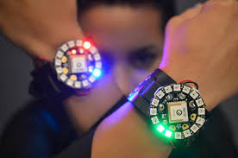
Arduino Based Watch
Internal Guide
Mr. Naveen
Mr. Neeraj
Team Member
Ankur Yadav
Archit Saxena
Arpit Saxena
Harendra

Slide 2
Overview
Introduction
Hardware Architecture
List of Components
Software Design

Slide 3
Introduction
The idea behind the title is to make arduino based programmable, fully functional electronic watch.
It will display time with the help of adafruit neopixel 12 RGB led ring, along with stopwatch and timer function
It will provide audio and visual notification while sensing and recording light, motion, sound and temperature.
The ability to sense and notify allows for a new variety of enhancements.
It will have a wearable sensor and notification platform developed social sites such as twitter, facebook etc.

Slide 4
It can also be used to track your heartbeat, body temperature sensor.
Also we will add a compass module to it, to tell the direction.

Slide 5
Things Required
Arduino Lilypad
DS3231 Real Time Clock
Neopixel Ring 12 RGB LED
LilyPad Push Button
Lithium Ion Polymer Battery
Battery Charger

Slide 6
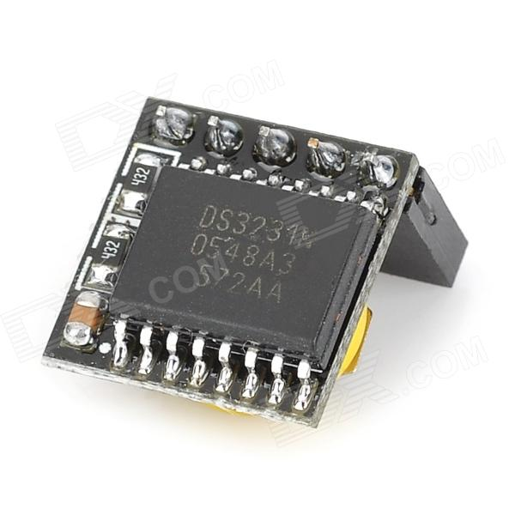
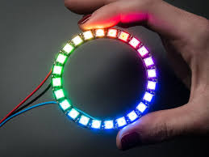
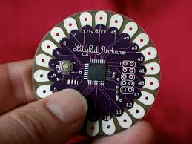
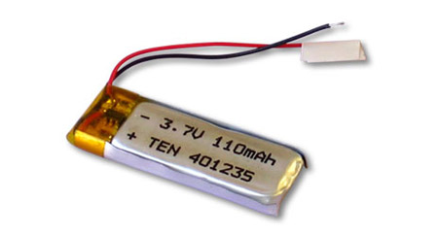
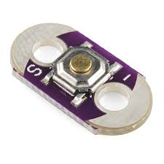

Slide 7
Hardware Architecture
The main CPU is Arduino Lilypad microcontroller.
For clock funtionality, we will use DS3231 Real Time Clock module and Neopixel RGB Led ring.
It communicates wirelessly using a HC-05 Bluetooth module that connects with android smartphone.
For sensing it will have photoresistors, LM 35 temperature sensor etc.
Two push buttons are distributed around the outside of the housing in the standard configuration of a digital watch.

Slide 8
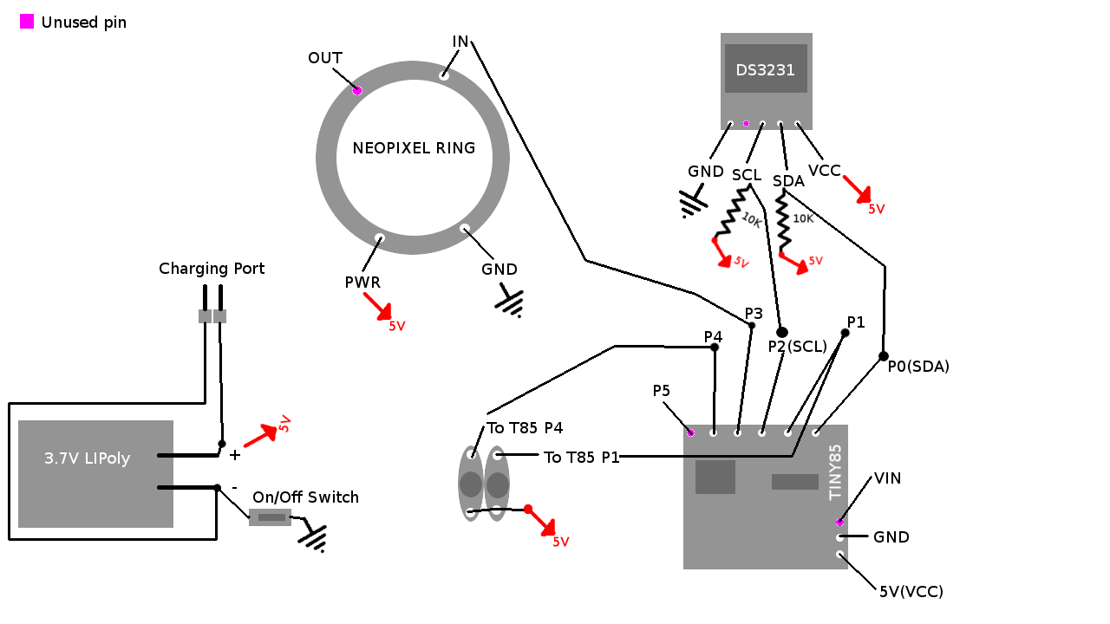

Slide 9
This watch will be powered by a 3.6 volt 700mAh rechargeable lithium polymer battery.
It would have a separate pcb that will rest over lilypad which will contain all sensors and bluetooth module.

Slide 10
Software Design
The Watch system was designed as a platform for developing as health monitor, context aware applications. The main goals that influenced the design decisions were ease of use and flexibility.
This Watch will provide the developer with an Android API for analysing your mood, health etc

Slide 11
Thank You

